Slide 1
Simulated Annealing , Ant Colony Optimization in Recommendation System
7th Oct 2019
Kuan Sao I

Slide 2
Content
Review
RS & types
K-means
Simulated Annealing
Using SA to combine K-means with CF for RS application
Ant Colony Optimization

Slide 3

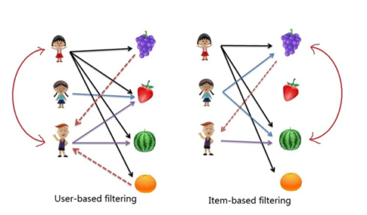
RS & types
Recommender Systems (RSs) are software tools and techniques providing suggestions for items to be of use to a user.
Types:
Demographic filtering(DF)
Collaborative filtering(CF)
Content-based filtering (CBF)
Hybrid approach (HA)
user profiles
interaction with users and items
Item descriptions and user profiles
mix above methods

Slide 4
K-means Clustering
K-means Clustering
dividing data points into homogeneous K classes or clusters by the mean value.
Notes:
https://medium.com/@imparth/k-means-clustering-algorithm-34807a7cec71

Slide 5
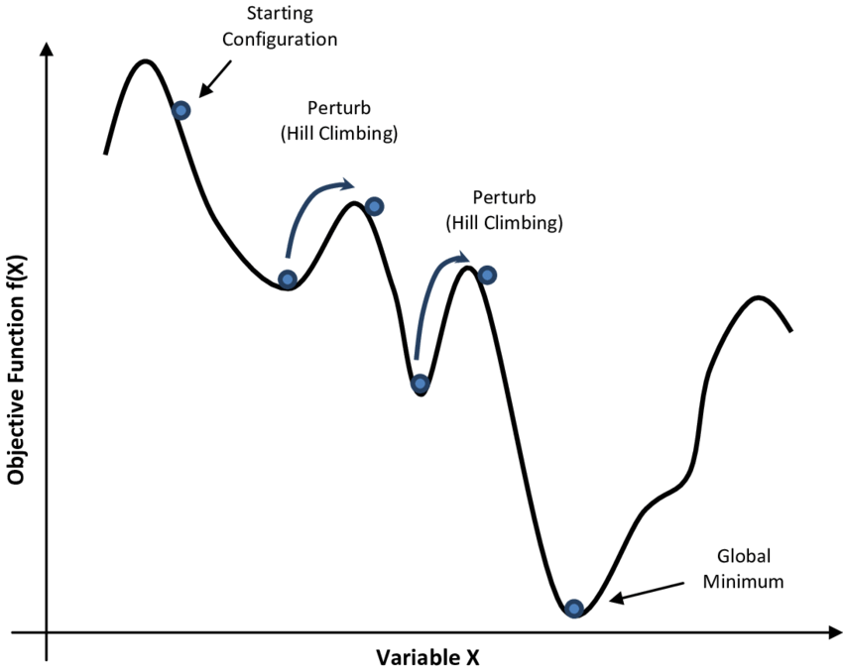
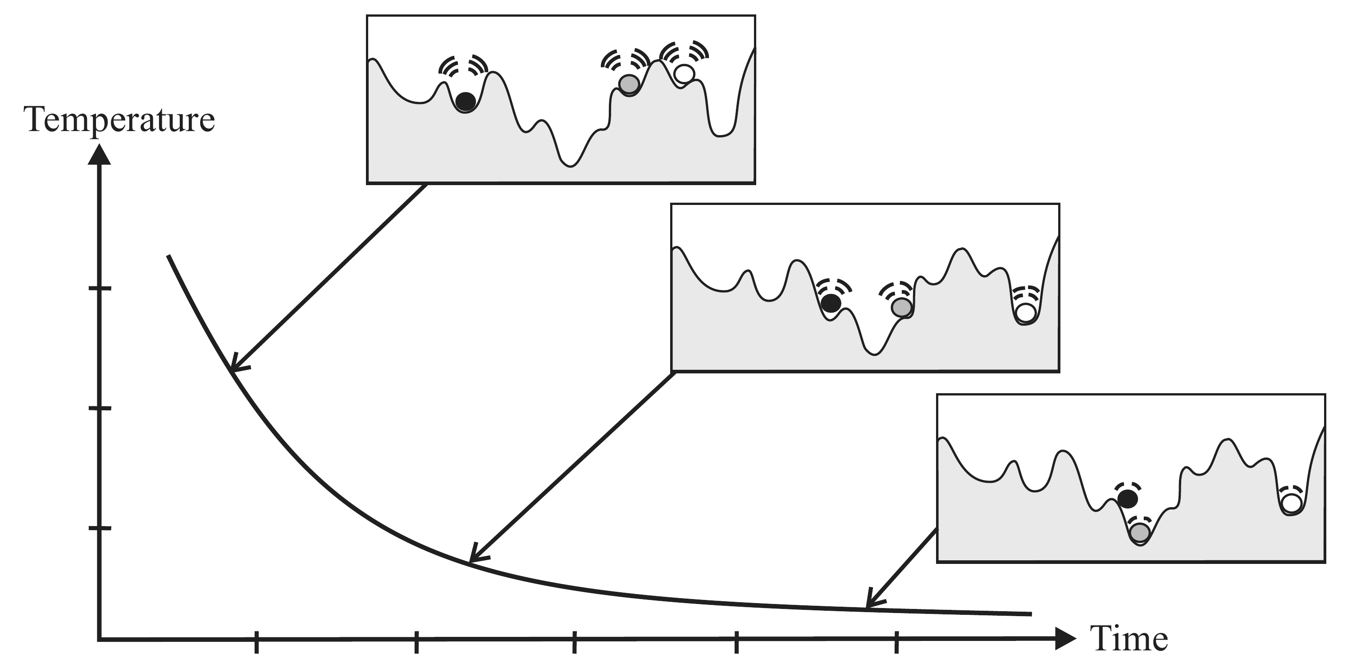
Simulated Annealing
Simulated annealing (SA) is a probabilistic technique for approximating the global optimum of a given function.
.
Notes:
https://en.wikipedia.org/wiki/Simulated_annealing
https://www.researchgate.net/figure/Simulated-Annealing-optimization-of-a-one-dimensional-objective-function_fig1_308786233

Slide 6
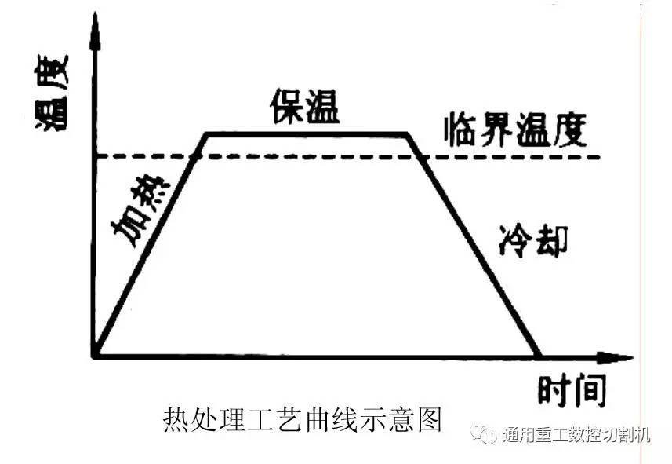
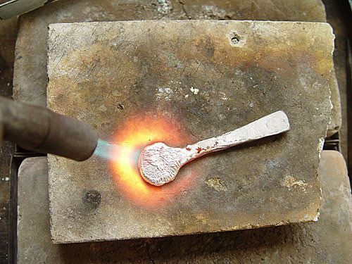
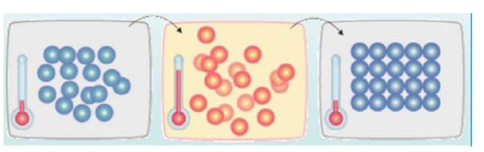
Simulated Annealing
Annealing is a heat treatment that alters the physical and sometimes chemical properties of a material to increase its ductility (延展性) and reduce its hardness as well as molecular rearrangement.
Annealing Process:
Heating
Isothermal
Cooling
Temp.
Isothermal
Threshold temp.
Heating
Cooling
time

Slide 7
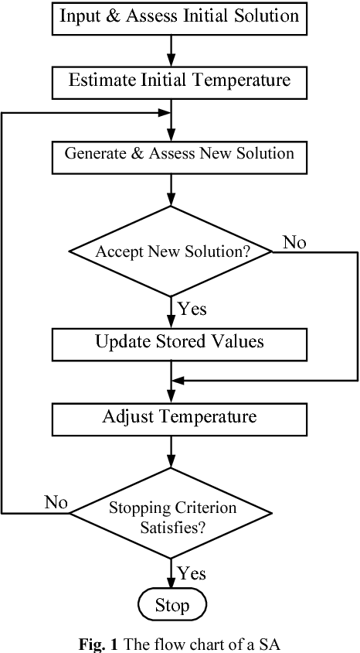
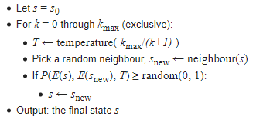
Simulated Annealing
Notes:
In order to apply the simulated annealing method to a specific problem, one must specify the following parameters: the state space, the energy (goal) function E(), the candidate generator procedure neighbour(), the acceptance probability function P(), and the annealing schedule temperature() AND initial temperature <init temp>.
https://en.wikipedia.org/wiki/Simulated_annealing

Slide 8
Application of Using Simulated Annealing to Combine Clustering with Collaborative Filtering for Item Recommendation (Z. Feng, Y. Su, 2013 )
CF
K-means
SA
Optimization
Widely used in RS
Cold start
Facing large scale data
Slow calculation
Classification
Facing large scale data
Slow calculation
Get better result

Slide 9
Application of Using Simulated Annealing to Combine Clustering with Collaborative Filtering for Item Recommendation (Z. Feng, Y. Su, 2013 )
Input: original rating matrix = 30000 +null rating + new user null rating
CF: predicted rating set = 3000, X={ x1,x2,…, x3000}
K-means: 5 clustered set = 600 x 5, S = { s1, s2, … , s5}, Y ={y1, y2, … , y600}
SA: optimized set = 600 Z ={z1, z2, … ,z600}
Output: potential predicted rating set = 600 , Z ={z1, z2, … ,z600}
 | I1 | I2 | I3 | I4
U1 |  | 5 |  | 3
U2 | 4 | 4 | 2 | 3
U3 |  |  | 2 | 3
U4 | 4 |  | 3
U5 | 4 | 4 |  | 2
 | I1 | I2 | I3 | I4
U1 | 5 |  | 3
U2
U3
U4 |  | 4 |  | 3
U5 |  |  | 2
 | I1 | I2 | I3 | I4
U1 | 5 |  | 3
U2
U3
U4 |  | 4 |  | 3
U5 |  |  | 2
 | I1 | I2 | I3 | I4
U1 | x |  | x
U2
U3
U4 |  | 4 |  | x
U5 |  |  | x
 | I1 | I2 | I3 | I4
U1
U2
U3
U4 |  | 4
U5
= S1
Test:>>>
U8 | 4 | 4 | 3 | x
= S2
= S3

Slide 10
Application of Using Simulated Annealing to Combine Clustering with Collaborative Filtering for Item Recommendation (Authors. Zhiming Feng, Yidan Su.)
CF
K-means
SA
Optimization
Widely used in RS
Facing large scale data
Slow calculation
Classification
Facing large scale data
Slow calculation
Get better result
 | Item1 | Item2 | Item3 | Item4
User1 |  | 5 |  | 3
User2 | 4 | 4 | 2 | 3
User3 |  |  | 2 | 3
User4 | 4 |  | 3
User5 | 4 | 4 |  | 2

Slide 11
Application of Using Simulated Annealing to Combine Clustering with Collaborative Filtering for Item Recommendation (Z. Feng, Y. Su, 2013 )
CF X={ x1,x2,…xn}
K-means
SA
Optimization
Widely used in RS
Facing large scale data
Slow calculation
Classification
Facing large scale data
Slow calculation
Get better result
 | Item1 | Item2 | Item3 | Item4
User1 | 5 | 5 | 3 | 3
User2 | 4 | 4 | 2 | 3
User3 |  |  | 2 | 3
User4 | 4 | 4 | 3 | 3
User5 | 4 | 4 | 2 | 2

Slide 12
Application of Using Simulated Annealing to Combine Clustering with Collaborative Filtering for Item Recommendation (Authors. Zhiming Feng, Yidan Su.)
CF
K-means S = { s1, s2, … , sn}
SA
Optimization
Widely used in RS
Facing large scale data
Slow calculation
Classification
Facing large scale data
Slow calculation
Get better result
 | Item1 | Item2 | Item3 | Item4
User1 | 5 | 5 | 3 | 3
User2 | 4 | 4 | 2 | 3
User3 |  |  | 2 | 3
User4 | 4 | 4 | 3 | 3
User5 | 4 | 4 | 2 | 2
= Cluster 1 (S1), Y ={y1, y2, … , yn}
= Cluster 2 (S2), Y ={y1, y2, … , yn}
= Cluster 3 (S3), Y ={y1, y2, … , yn}

Slide 13
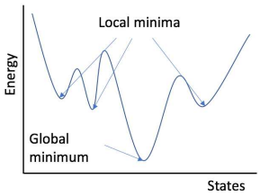
Application of Using Simulated Annealing to Combine Clustering with Collaborative Filtering for Item Recommendation (Z. Feng, Y. Su, 2013 )
CF
K-means
SA Z={z1, z2, … , zn}
Optimization
Widely used in RS
Facing large scale data
Slow calculation
Classification
Facing large scale data
Slow calculation
Get better result
 | Item1 | Item2 | Item3 | Item4
User1 | 5 | 5 | 3 | 3
User2 | 4 | 4 | 2 | 3
User3 |  |  | 2 | 3
User4 | 4 | 4 | 3 | 3
User5 | 4 | 4 | 2 | 2
Temp.
= Cluster 1 (S1)
= Cluster 2 (S2)
= Cluster 3 (S3)
Time
Notes:
https://arxiv.org/pdf/1807.10750.pdf

Slide 14
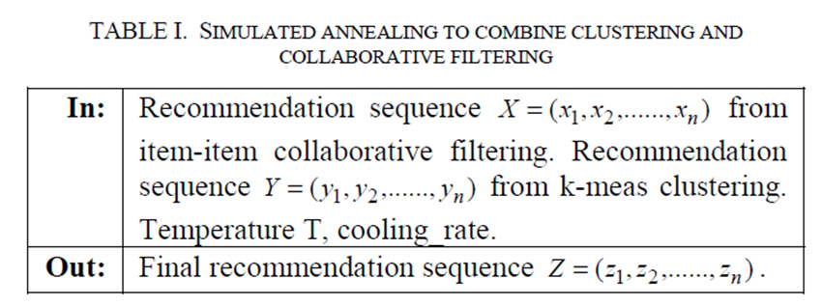
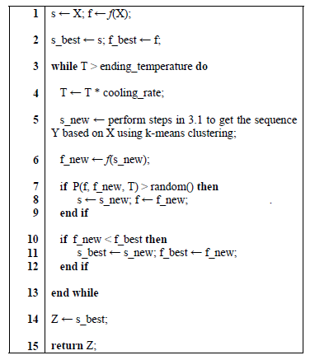
1st iteration:
s_best = S = X
f_best = f = f(X) = x1 = (Δ = N(x) – x1, Δ ≤ 0 )
While T=1000 > 1 do
T = 1000* cooling_rate 0.9 =900
s_new = Y1
f_new = f(Y1) = y1,1 = (Δ =N(y1) – y1,1, Δ ≤ 0 )
If P(f,f_new,T) = exp(−( f (Y1) − f (X )) /T)
=exp(-y1,1- x1)/900
> random() then
s = s_new = Y1
f = f_new = y1,1
End if
If f_new (y1,1) < f_best(x1) then
s_best = s_new =Y1
f_best = f_new =y1,1
End if
End while
Z = Y1
f : payoff function
x’:neighborhood of x
neighborhood of x denoted N(x)
Δ = f (x') − f (x)
The acceptance function:
P = e(−Δ) / T
Notes:
[10]Application of Using Simulated Annealing to Combine Clustering with Collaborative Filtering for Item Recommendation

Slide 15
f : payoff function
x’: neighborhood of x
neighborhood of x denoted N(x)
Δ = f (x') − f (x)
The acceptance function:
P = e(−Δ) / T
Acceptance function P
Is P(f,f_new,T)
= exp( -(f(Y1) – f(X)) / T) =exp(-(y1,1 – x1) )/ 900
>random()?
start
No
Yes
s = X
T=1000
cooling_rate = 0.9
s = s_new,
f = f_new
Is f_new (y1,1) < f_best(x1) ?
f = f(X)
= x1 = ( 𝝙 = N(x) – x1, 𝝙 ≤ 0)
s_best = s,
f_best = f
No
Yes
s_best = s_new,
f_best = f_new,
T = T* cooling_rate
Z = s_best
end_temp?
s_new = Y1
No
Yes
f_new = f(Y1)
= y1,1 ( 𝝙 = N(y1)– y1,1, 𝝙 ≤ 0)
retuen Z
end

Slide 16
Application of Using Simulated Annealing to Combine Clustering with Collaborative Filtering for Item Recommendation (Z. Feng, Y. Su, 2013 )
Input: original rating matrix = 30000
CF: predicted rating set = 3000 X={ x1,x2,…, x3000}
K-means: 5 clustered set = 600 x 5 S = { s1, s2, … , s6}, Y ={y1, y2, … , y600}
SA: optimized set = 600 Z ={z1, z2, … ,z600}
Output: potential predicted rating set = 600 , Z ={z1, z2, … ,z600}
 | I1 | I2 | I3 | I4
U1 |  | 5 |  | 3
U2 | 4 | 4 | 2 | 3
U3 |  |  | 2 | 3
U4 | 4 |  | 3
U5 | 4 | 4 |  | 2
 | I1 | I2 | I3 | I4
U1 | 5 |  | 3
U2
U3
U4 |  | 4 |  | 3
U5 |  |  | 2
 | I1 | I2 | I3 | I4
U1 | 5 |  | 3
U2
U3
U4 |  | 4 |  | 3
U5 |  |  | 2
 | I1 | I2 | I3 | I4
U1 | x |  | x
U2
U3
U4 |  | 4 |  | x
U5 |  |  | x
 | I1 | I2 | I3 | I4
U1
U2
U3
U4 |  | 4
U5
= S1
Test:>>>
U8 | 4 | 4 | 3 | x
= S2
= S3

Slide 17
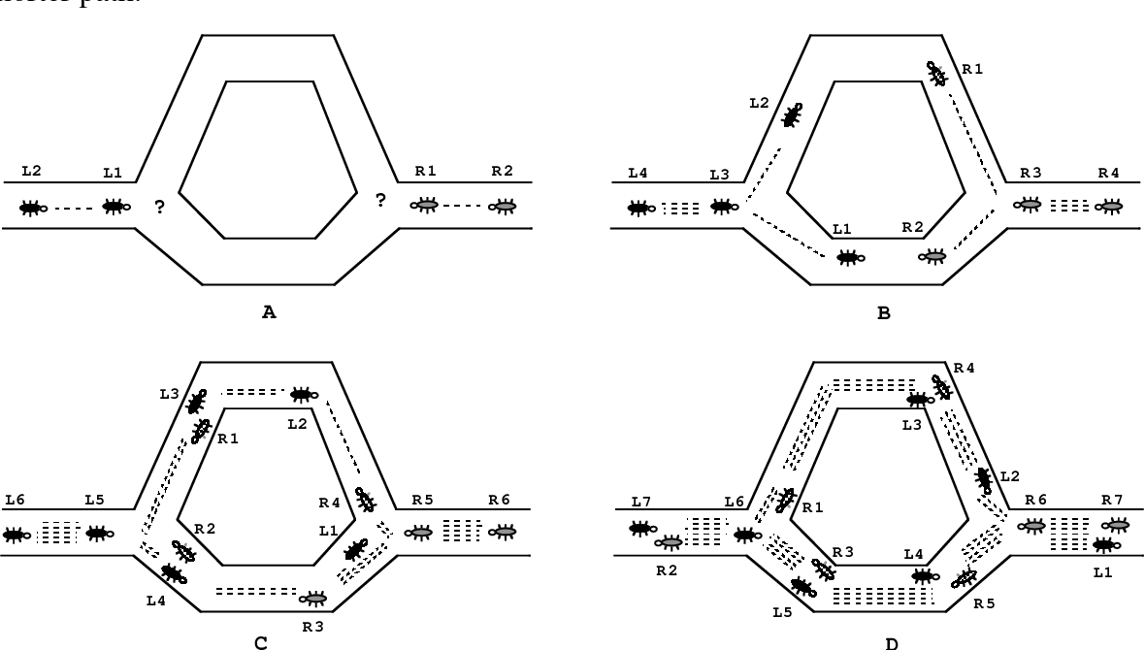
Ant Colony Optimization
ACO copies blind ants’ behavior, who to find food on the shortest path form ant nest (TSP).
Base on pheromone of pervious ants, they are able to follow it to find the path randomly as the probability of pheromone.
Notes:
Student Courses Recommendation Using Ant Colony Optimization
By Janusz Sobecki and Jakub M. Tomczak

Slide 18
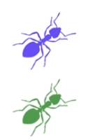
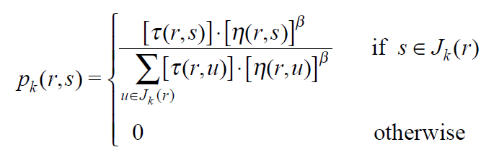
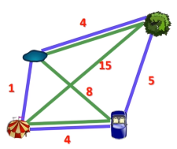

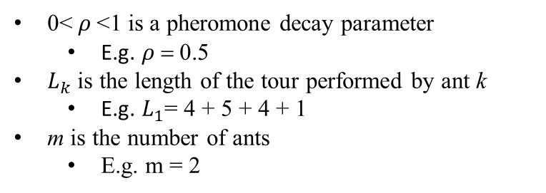
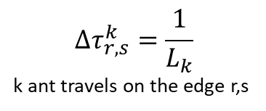
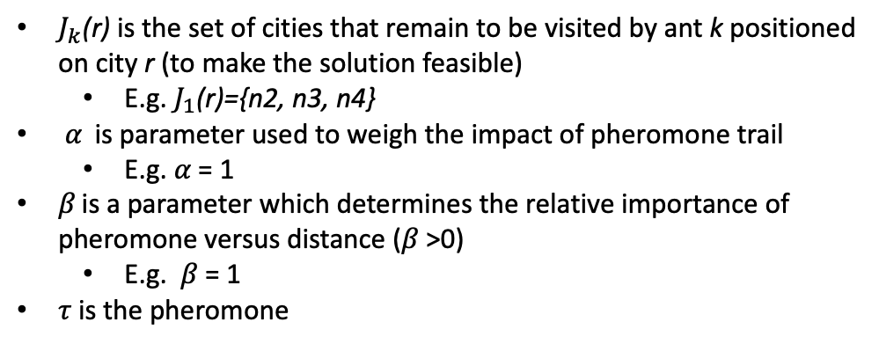
ACO
The probability with which ant k in city r chooses to move to the city s.
E.g. k = 1 ; r = n1; s = n4
𝛼
k = 1 (purple path)
k = 2 (green path)
𝛼
where: η(r,s) =1/d (r,s)
E.g. η(n1,n4) =1/4 (dist: n1 to n4)
Node 3
Node 2
$J_{k}$(r) is the set of cities that remain to be visited by ant k positioned on city r (to make the solution feasible)
E.g. $J_{1}$(r)={n2, n3, n4}
𝛼 is parameter used to weigh the impact of pheromone trail
E.g. 𝛼 = 1
𝛽 is a parameter which determines the relative importance of pheromone versus distance (𝛽 >0)
E.g. 𝛽 = 1
𝜏 is the pheromone
Node 1
Node 4
Dist. | n1 | n2 | n3 | n4
n1 | 0 | 1 | 15 | 4
n2 | 1 | 0 | 4 | 8
n3 | 15 | 4 | 0 | 5
n4 | 4 | 8 | 5 | 0
0< $ρ$<1 is a pheromone decay parameter
E.g. $ρ$ = 0.5
$L_{k}$is the length of the tour performed by ant k
E.g. $L_{1}$= 4 + 5 + 4 + 1
m is the number of ants
E.g. m = 2
$$Δτ_{r,s}^{k}=\frac{1}{L_{k}}$$
k ant travels on the edge r,s
Notes:
A statistical analysis of parameter values for the rank-based ant colony optimization algorithm for the traveling salesperson problem
https://www.researchgate.net/publication/220636414_A_statistical_analysis_of_parameter_values_for_the_rank-based_ant_colony_optimization_algorithm_for_the_traveling_salesperson_problem
Ant Colony System: A Cooperative Learning Approach to the Traveling Salesman Problem
https://www.researchgate.net/publication/220636414_A_statistical_analysis_of_parameter_values_for_the_rank-based_ant_colony_optimization_algorithm_for_the_traveling_salesperson_problem

Slide 19
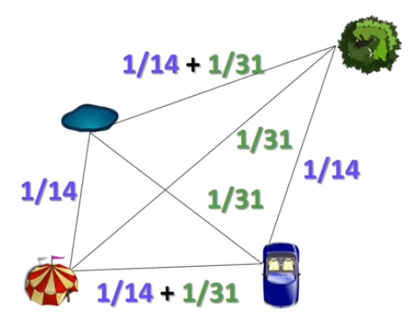
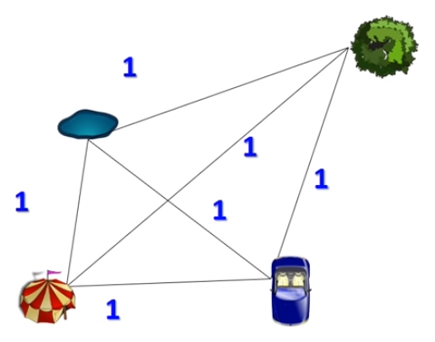
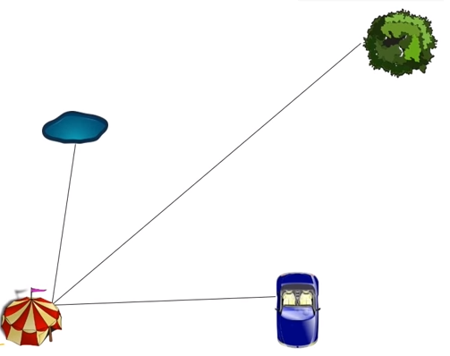
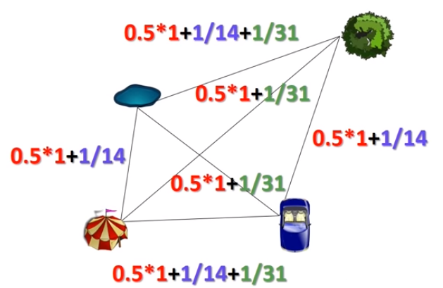

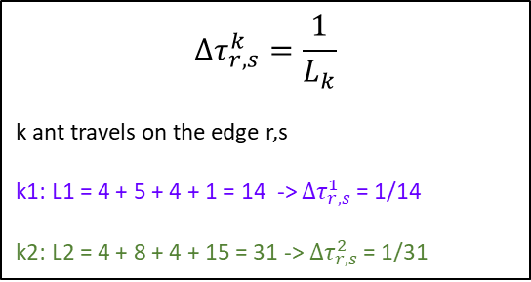
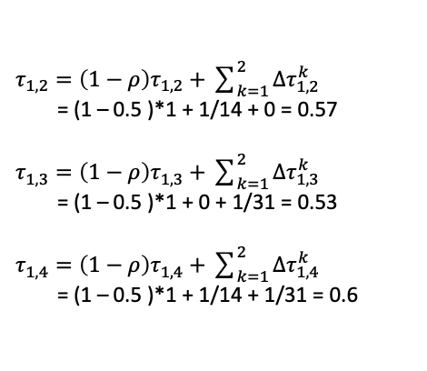

E.g. τ
𝛼
𝛼
Node 2
Node 3
k = 1 (purple path)
k = 2 (green path)
$$Δτ_{r,s}^{k}=\frac{1}{L_{k}}$$
k ant travels on the edge r,s
k1: L1 = 4 + 5 + 4 + 1 = 14 -> $Δτ_{r,s}^{1}$ = 1/14
k2: L2 = 4 + 8 + 4 + 15 = 31 -> $Δτ_{r,s}^{2}$ = 1/31
Node 1
Node 3
Node 4
Node 2
Let pheromone graph as $τ_{0}^{}=$1 for each path
Node 3
Node 1
Node 2
Node 4
Node 1
Node 4
Dist. | n1 | n2 | n3 | n4
n1 | 0 | 1 | 15 | 4
n2 | 1 | 0 | 4 | 8
n3 | 15 | 4 | 0 | 5
n4 | 4 | 8 | 5 | 0
$τ_{1,2}^{}=\left(1−ρ\right)τ_{1,2}^{}+\sum_{k=1}^{2}{Δτ_{1,2}^{k}}$
= (1 – 0.5 )*1 + 1/14 + 0 = 0.57
$τ_{1,3}^{}=\left(1−ρ\right)τ_{1,3}^{}+\sum_{k=1}^{2}{Δτ_{1,3}^{k}}$
= (1 – 0.5 )*1 + 0 + 1/31 = 0.53
$τ_{1,4}^{}=\left(1−ρ\right)τ_{1,4}^{}+\sum_{k=1}^{2}{Δτ_{1,4}^{k}}$
= (1 – 0.5 )*1 + 1/14 + 1/31 = 0.6
τ. | n1 | n2 | n3 | n4
n1 | 0 | 0.57 | 0.53 | 0.6
n2 | 0.57 | 0 | 0.6 | 0.53
n3 | 0.53 | 0.6 | 0 | 0.57
n4 | 0.6 | 0.53 | 0.57 | 0
𝛼 = 1, 𝛽 = 1, m = 2, $ρ$ = 0.5
Notes:
A statistical analysis of parameter values for the rank-based ant colony optimization algorithm for the traveling salesperson problem
https://www.researchgate.net/publication/220636414_A_statistical_analysis_of_parameter_values_for_the_rank-based_ant_colony_optimization_algorithm_for_the_traveling_salesperson_problem
Ant Colony System: A Cooperative Learning Approach to the Traveling Salesman Problem
https://www.researchgate.net/publication/220636414_A_statistical_analysis_of_parameter_values_for_the_rank-based_ant_colony_optimization_algorithm_for_the_traveling_salesperson_problem

Slide 20
E.g. Probability
τ0. | n1 | n2 | n3 | n4
n1 | 0 | 0.57 | 0.53 | 0.60
n2 | 0.57 | 0 | 0.60 | 0.53
n3 | 0.53 | 0.60 | 0 | 0.57
n4 | 0.60 | 0.53 | 0.57 | 0
Node 2
Node 3
k = 1 (purple path)
k = 2 (green path)
Node 1
Node 3
Node 4
Node 2
k=1,
p1(1,2) = (0.57)^1 * (1/1)^ 1 /
((0.57)^1 * (1/1)^1 +
(0.57)^1 * (1/15)^1 +
(0.57)^1 * (1/4)^1)) = 0.76
p1(1,3) = (0.53)^1 * (1/15)^ 1 /
((0.53)^1 * (1/1)^1 +
(0.53)^1 * (1/15)^1 +
(0.53)^1 * (1/4)^1)) = 0.05
p1(1,4) = (0.60)^1 * (1/4)^ 1 /
((0.60)^1 * (1/1)^1 +
(0.60)^1 * (1/15)^1 +
(0.60)^1 * (1/4)^1)) = 0.19
𝛼
𝛼
Node 1
Node 4
where: η(r,s) =1/d (r,s)
E.g. η(n1,n4) =1/4 (dist: n1 to n4)
Dist. | n1 | n2 | n3 | n4
n1 | 0 | 1 | 15 | 4
n2 | 1 | 0 | 4 | 8
n3 | 15 | 4 | 0 | 5
n4 | 4 | 8 | 5 | 0
76%
Node 3
5%
Node 2
roulette random number in [0,1]:
0≤ r ≤0.05 = Node 3
0.05< r ≤ (0.05 + 0.19 = 0.24) = Node 4
0.24< r ≤ (0.24 + 0.76 = 1.00 ) = Node 2
𝛼 = 1, 𝛽 = 1, m = 2, $ρ$ = 0.5
Node 1
Node 4
19%
Notes:
A statistical analysis of parameter values for the rank-based ant colony optimization algorithm for the traveling salesperson problem
https://www.researchgate.net/publication/220636414_A_statistical_analysis_of_parameter_values_for_the_rank-based_ant_colony_optimization_algorithm_for_the_traveling_salesperson_problem
Ant Colony System: A Cooperative Learning Approach to the Traveling Salesman Problem
https://www.researchgate.net/publication/220636414_A_statistical_analysis_of_parameter_values_for_the_rank-based_ant_colony_optimization_algorithm_for_the_traveling_salesperson_problem

Slide 21
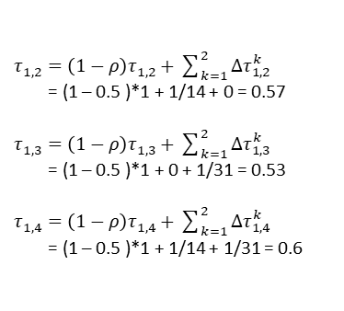

ACO
$$Δτ_{r,s}^{k}=\frac{1}{L_{k}}$$
k ant travels on the edge r,s
k1: L1 = 4 + 5 + 4 + 1 = 14 -> $Δτ_{r,s}^{1}$ = 1/14
k2: L2 = 4 + 8 + 4 + 15 = 31 -> $Δτ_{r,s}^{2}$ = 1/31
76%
Node 3
5%
Node 2
Node 1
Node 4
19%
Choose a node to move
Generate a path
Calculate total distance(length) of the path
Generate all path for all ants
Spread pheromone
Get the shortest path
$τ_{1,2}^{}=\left(1−ρ\right)τ_{1,2}^{}+\sum_{k=1}^{2}{Δτ_{1,2}^{k}}$
= (1 – 0.5 )*1 + 1/14 + 0 = 0.57
$τ_{1,3}^{}=\left(1−ρ\right)τ_{1,3}^{}+\sum_{k=1}^{2}{Δτ_{1,3}^{k}}$
= (1 – 0.5 )*1 + 0 + 1/31 = 0.53
$τ_{1,4}^{}=\left(1−ρ\right)τ_{1,4}^{}+\sum_{k=1}^{2}{Δτ_{1,4}^{k}}$
= (1 – 0.5 )*1 + 1/14 + 1/31 = 0.6
Node 3
Node 2
𝛼
𝛼
Node 1
Node 4

Slide 22
start
start
start
visited node = set( )
start node = 0
visited node += start node
prev = start node
dist_mtx = dist_mtx
⍺ = 1 , β = 1
total_dist = 0
node[ele] = dist_mtx[ele]
tau_mtx= 1 / dist_mtx
tau = tau_mtx
remain nodes = len(dist_mtx) - 1
Is node in path?
remain nodes > 0
No
tau [visited node] = 0
Yes
No
Yes
total_dist += node [ele]
p_num = tau ^ ⍺ * 1 / dist_mtx ^ β
path += (prev, move)
prev = move
visited node += set(move)
return total_dist
p = p_num / sum(p_num)
move = p
( pick a node , roulette method )
end
remain nodes -= 1
return move
path +=( prev, start node)
end
return path
N1 >N2
N1 >N2>N3>N4
end

Slide 23
start
start
start
decay = 0.5, t = 10
sort_paths = all_paths
n_ants = 2
all_paths = all_paths
path, dist in sort_paths?
No
spread_tau
all ants dept. ?
No
Yes
shortest_path = min (all_path)
Yes
move in path?
No
Is shortest_path < Gb_shortest_path ?
all_paths += (path, total_dist)
Yes
No
tau[move] += 1 / dist[move]
Yes
Gb_shortest_path = shortest_path
return all_paths
stop
tau * decay,
t = t + 1
end
end
t < 10
Yes
No
end
return Gb_shortest_path

Slide 24
A research of collaborative filtering recommendation based on ant colony algorithm (Y. Wu, Y. Du, L. Li, 2011)
CF
Cold start
Slow query speed
K-means
How to choose K correctly?
ACO
Speed up for CF
Auto clustering
Feature Weighting for ACO clustering
Further studies
Solve cold start by α, β
Users rating time difference

